Slide 1
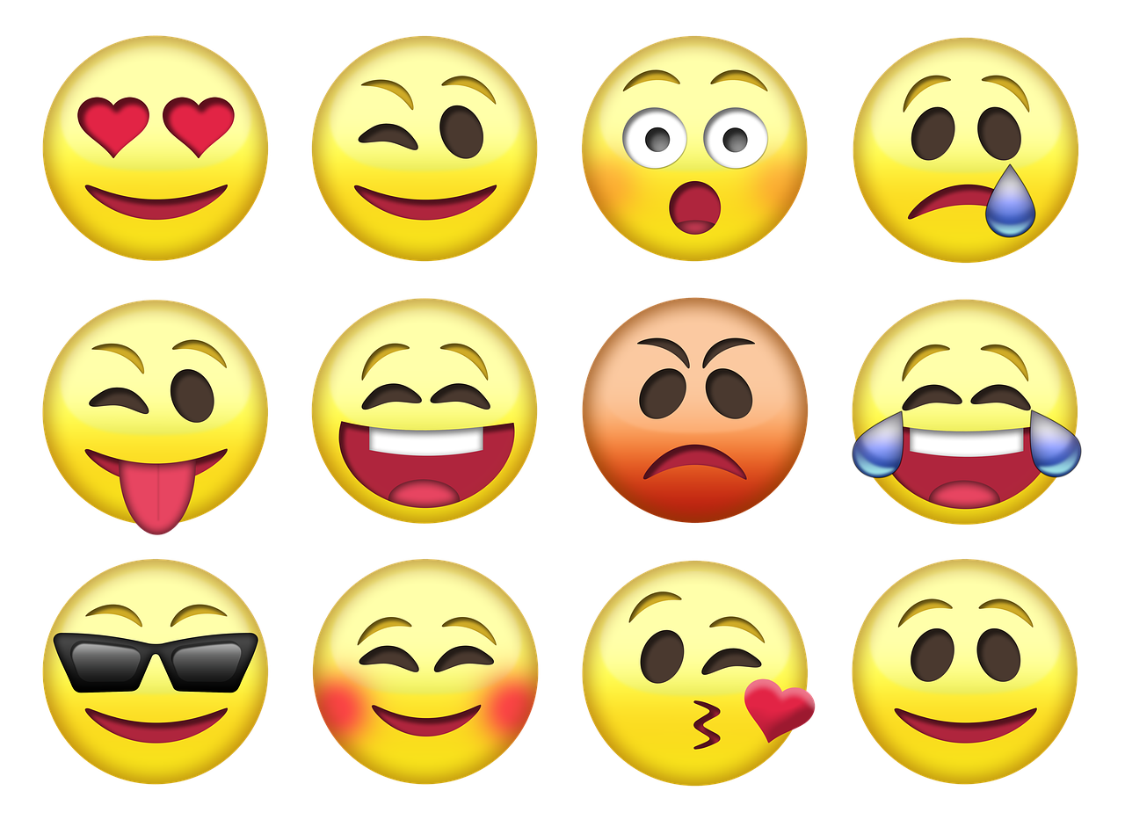
Let’s Get Moody!
Tips For Incorporating Musical Expression Into Your Performance

Slide 2
How Do You Plan Your Phrase Making Decisions?
Like any other language, music’s true nature lies in communication. To give music greater meaning, the performer must ask, “what message is the composer trying to convey to their listeners?” This type of detective work can feel so arbitrary at times but if the performer knows what to look for in the piece, they can be more deliberate about their phrase making decisions. Every phrase should be premeditated thoughtfully, and planned precisely prior to the performance.
Notes:
Like any other language, music’s true nature lies in communication. To give music greater meaning, the performer must ask, “what message is the composer trying to convey to their listeners?” This type of detective work can feel so arbitrary at times but if the performer knows what to look for in the piece, they can be more deliberate about their phrase making decisions. Every phrase should be premeditated thoughtfully, and planned precisely prior to the performance. Below are some tips to help quantify the phrasing process.

Slide 3

Look for changes in texture in your piece. A change in texture usually defines where a phrase begins and ends or if it is an elision.
Cadence
Key change
Meter change
Rhythmic cadence (i.e. diminution)
Dynamic change
Articulation changes
Register changes

Slide 4


Analyze the Phrase Harmonically - How does it function, is it dominant or tonic?
Dominant = tension/conflict/chromatic
Bring out the dramatic non chord tones
Tonic = release/home/resolution
Look for cadences
Tension Release

Slide 5



Bring the Phrase to the “Note of Change” (usually crescendo)
Crescendo through repeated notes and held notes
Is there a sequence/pattern?
  Where does the sequence or pattern change?
  Build the phrase through the sequence bringing the audience to the change in sequence.

Slide 6




Identify the main characters.
Hint: There are usually at least two characters/themes in pieces written in the common practice period.
Use descriptive words to identify them
Dolce Playful Assertive Dramatic Angry/Fiery

